Slide 1
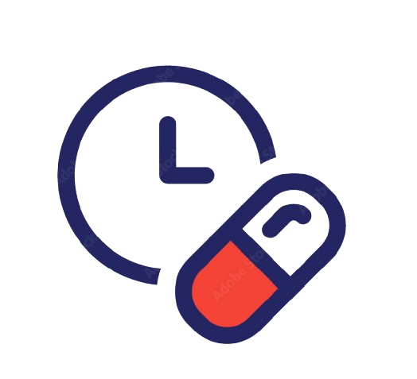

MyDose
Smart Medicinal Web System
Made by
Priyanka Chaurasia
Priyasha Dutta

Slide 2
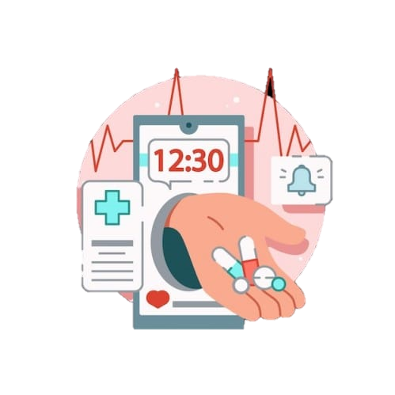
Idea Title
Problem Statement
Medication non-adherence is a major healthcare issue, especially among elderly and chronic patients.
Patients often forget medicines due to complex schedules.
Lack of monitoring leads to missed doses and health complications.
Rural areas have limited caregiver and healthcare supervision .
Solution Proposed
A web-based medicine management system.
Users can add medicine schedules and receive reminders.
Tracks adherence and generates health reports.
Enables caregiver monitoring through dashboard access.

Slide 3





Technical Approach
Technology Stack
css
Frontend: HTML, CSS
Backend: Python (Flask Framework)
Database: SQLite
IDE: Visual Studio Code
Platform: Web Application (Browser-based)
Python
Key Features
Medicine scheduling
Reminder alerts
Dose tracking
Adherence analytics dashboard

Slide 4
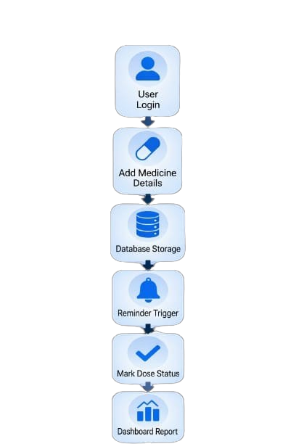
Technical Flow
System Flow
User logs into system.
Adds medicine details (name, dosage, time).
Data stored in database.
Reminder triggers at scheduled time.
User marks dose as taken or missed.
Dashboard updates adherence report.

Slide 5
Feasibility & Viability
Built using lightweight
Flask framework.
Runs on low-spec devices.
No expensive hardware required.
Easy-to-use interface.
Accessible through mobile or desktop browser.
Suitable for elderly and caregivers.
Open-source technologies used.
Low development and deployment cost .
Scalable for hospitals and clinics.
Technical Feasibility
Operational Feasibility
Financial Feasibility

Slide 6
Impact & Benefits
Improves medicine-taking habits.
Reduces health risks and missed doses.
Supports elderly and rural patients .
Promotes digital healthcare awareness
Impact
Benefits
Easy medicine schedule management.
Caregiver can monitor remotely.
Low-cost and easy to use.
Saves time and healthcare expenses.

Slide 7
THANK YOU !

